Slide 1
VIHA 2018 Annual Meeting
January 23, 2018
Lutheran Church of the Cross

Slide 2
VIHA 2018 Annual Meeting
DON HERRING, SPPD
Community Crime Report

Slide 3
VIHA 2018 Annual Meeting
Guest Speaker
JOHN ROMANO

Slide 4
VIHA 2018 Annual Meeting
BUSINESS MEETING

Slide 5
2018 Officers and Board Members
Officers
President – Rich Scanlon
Vice President – no nominee
Treasurer – Lisa Schwartz
Secretary – Linda Testa
Board Members
John Bodimer Mark Brenman
Bob Johnson Chuck Miller
Alexander Janus (*) Tom Testa
Randy Havey (**) Steve Cropper (**)
(*) Newly elected (**) Appointed, pending Board approval.

Slide 6
2017 Accomplishments
Increased number of VIHA members from 327 (61.4%) to 346 (65.0%) of the 525 properties
Sent out resident survey that has driven Board priorities
Began discussions with homeowner association management companies
Replacement light pole installed along the sidewalk Mass. Ave and Grand Canal
Planted the Royal Palms on the Overlook entrance to VI
Facilitated seawall repair (ongoing)
Traffic calming device installed on Overlook
Initiated Property of the Month Award
Successful Oktoberfest – second in a row after a several year hiatus
Added a "Social Hour" prior to Annual /General Meetings

Slide 7
2018 Goals
Construction of new monuments to replace existing structures
Retain homeowner association management company
Offer fishing and golf tournaments
Continue traffic monitoring on Grand Canal
Provide lighting for Royal Palms installed on Overlook
Increase membership in VIHA to 368 homeowners (70.0%)
Further advance concept of mandatory VIHA Membership and dues payment
Invite appropriate speakers to Annual/General Meetings

Slide 8
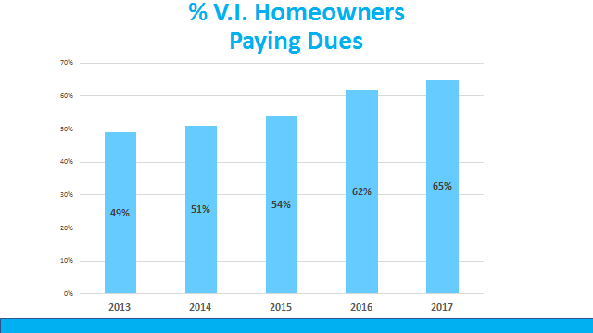
Growth in VIHA Membership
Increase from 2013 to 2017 represents 84 properties.

Slide 9
Information Available on VIHA Website
Welcome – Informational Resources
Deed Restrictions
Architectural Review Committee
FAQ’s
News and Events
Crime Watch
Advertise in VI
Beautification Corner
Property of the Month

Slide 10
Management Company Initiative
VIHA has been dependent upon volunteers for undertaking the functions necessary for continued operations
Volunteers are harder to come by
Management company can support the efforts of a committed group of volunteers
Would require mandatory membership in VIHA and payment of dues

Slide 11
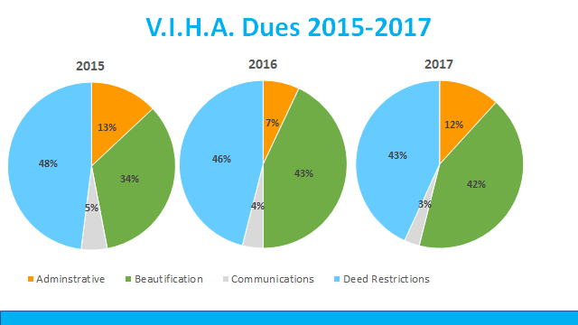
Use of VIHA Annual Dues

Slide 12
Examples of Budget Category Expenditures
Deed Restrictions
Legal Fees
Budgeting funds for a management co.
Beautification
Landscaping/maintenance of common areas
Mangrove trimming
Purchase and installation of Royal Palms on Overlook
Administrative
Insurance
Postage
Communications
Printing and sandwich boards
Web site maintenance and fees

Slide 13
Closing Items
Photo Contest Winner
Open discussion on VI items of importance
Door Prize drawing

